Slide 1
CSS screens as webpages using webopi

Slide 2
Necessary software
Java 1.6 and up
Apache Tomcat 7.0
Webopi
Beamline CSS screens

Slide 3
Installation & configuration
Java
Installed on beamline workstations
Tomcat
http://tomcat.apache.org/
Webopi
Download webopi.war into $(TOMCAT)/webapps/
https://controlssoftware.sns.ornl.gov/css_rcp/updates/apps/
Configuration
http://htmlpreview.github.io/?https://github.com/ControlSystemStudio/cs-studio/blob/master/applications/opibuilder/opibuilder-plugins/org.csstudio.opibuilder.rap/html/WebOPI.html

Slide 4
Installation & configuration
Webopi
css_rap.ini
EPICS environment
webopi environment
conf/catalina.properties
Point to css_rap.ini
org.csstudio.platform.libs.epics/addr_list=127.0.0.1 10.28.0.255
org.csstudio.platform.libs.epics/max_array_bytes=20000000
org.csstudio.opibuilder/opi_repository=/opt/css/opi/production/cs-studio-xf/28id
org.csstudio.opibuilder/startup_opi=main.opi
org.csstudio.opibuilder/mobile_startup_opi=mobile/mobile-main.opi
org.csstudio.rap.preference=/opt/tomcat/conf/css_rap.ini

Slide 5
Installation & configuration
Webopi
conf/server.xml
Network
compression
<Connector port="80"
...
compression="on"
compressionMinSize="1024“
compressableMimeType="text/html, text/xml, text/plain, text/javascript, application/json"/>

Slide 6
Access
Web Access URL
Main entry
http://your_site.com/webopi
Rename webopi to your_name and use
http://your_site.com/your_name
Debug
http://your_site.com/your_name/rap?startup=debug
More lines for debug
http://your_site.com/webopi/rap?startup=debug&lines=500

Slide 7
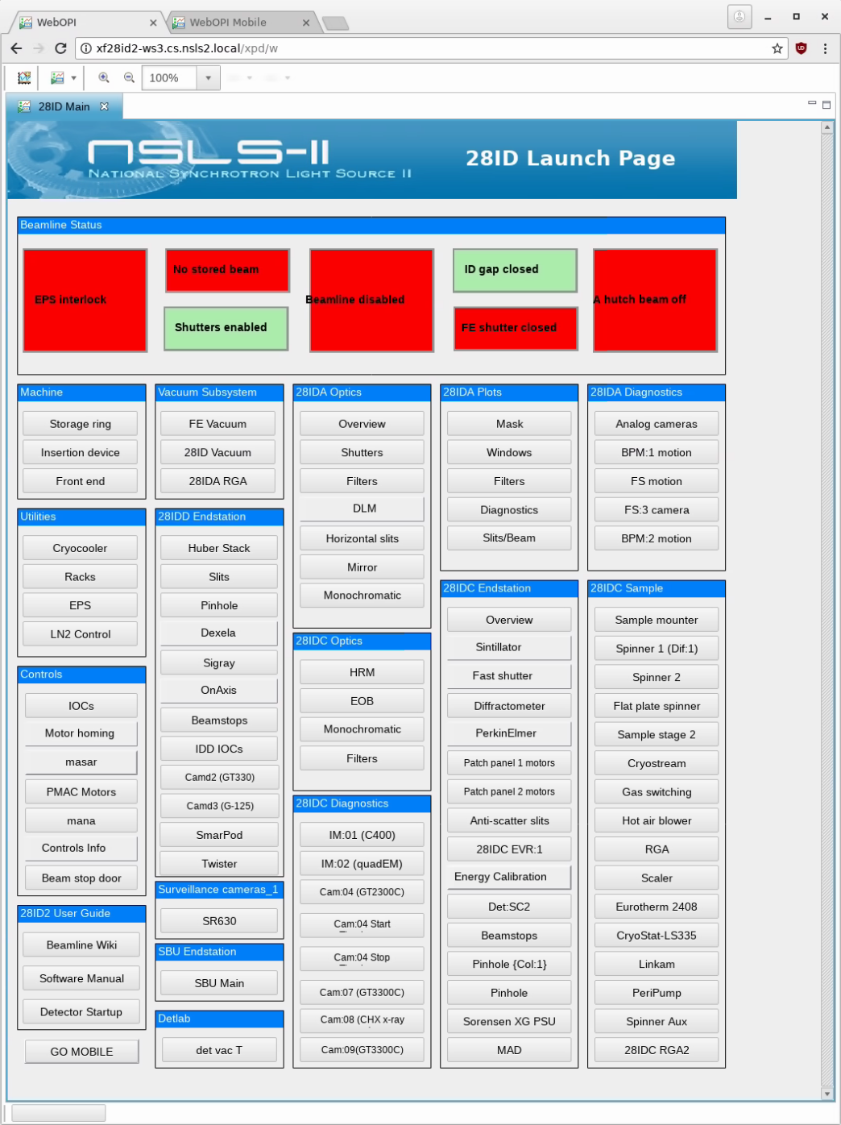
Access
startup_opi
http://xf28id2-ws3.cs.nsls2.local/xpd/w

Slide 8
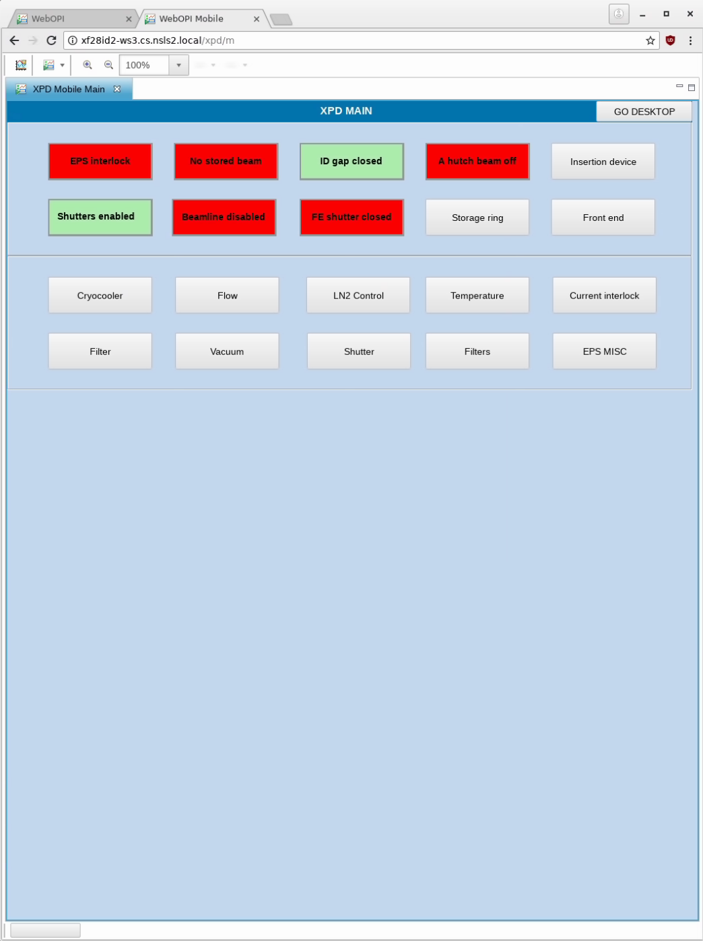
Access
mobile_startup_opi
http://xf28id2-ws3.cs.nsls2.local/xpd/m

Slide 9
Cons
Required a lot of CPU, memory and network bandwidth.
Was only able to support a few concurrent users and resulted in very slow update rates.
The Display Builder Web Runtime is a replacement project that offers much better performance.

